Slide 1


CS 302 Final Presentation
Campus
Chow
2025
Matthew, Yang Hwee, Xu Duo, Doris, Lennel, Shiv

Slide 2
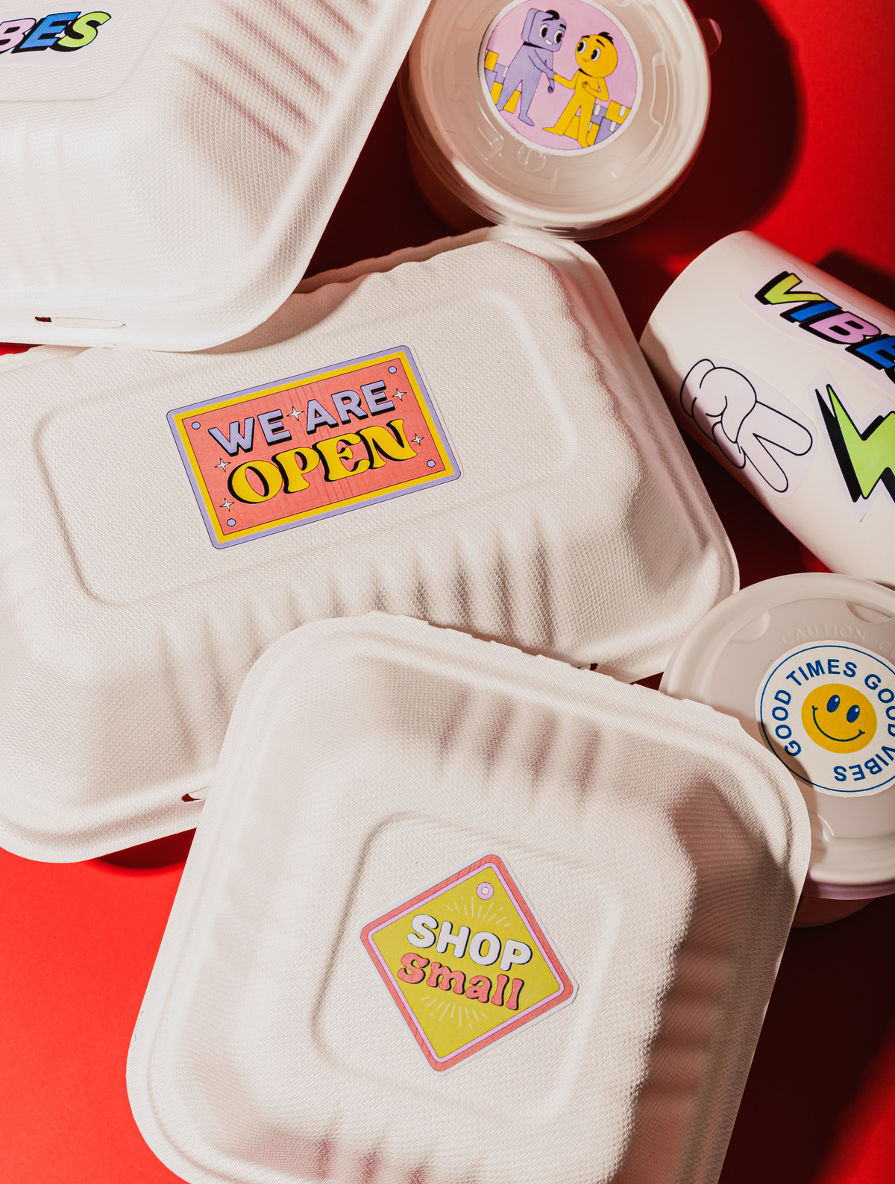
The Problem We Saw on Campus
When students have back-to-back classes, finding time to eat can become challenging. Students often have to rush between lectures with little to no break, making it difficult to buy or eat food without risking being late.

Slide 3

Our Solution
Campus CHOW is a student-driven platform that enables group food orders at SMU. It matches students by class schedules with food runners, addressing short breaks and limited delivery options, while providing flexible income opportunities.

Slide 4
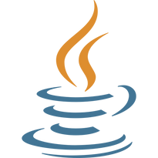


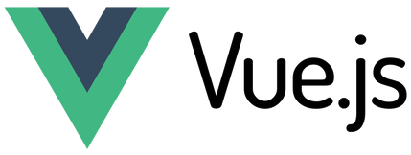


Our Stack at a Glance
Backend
Frontend
Devops/Deployment

Slide 5
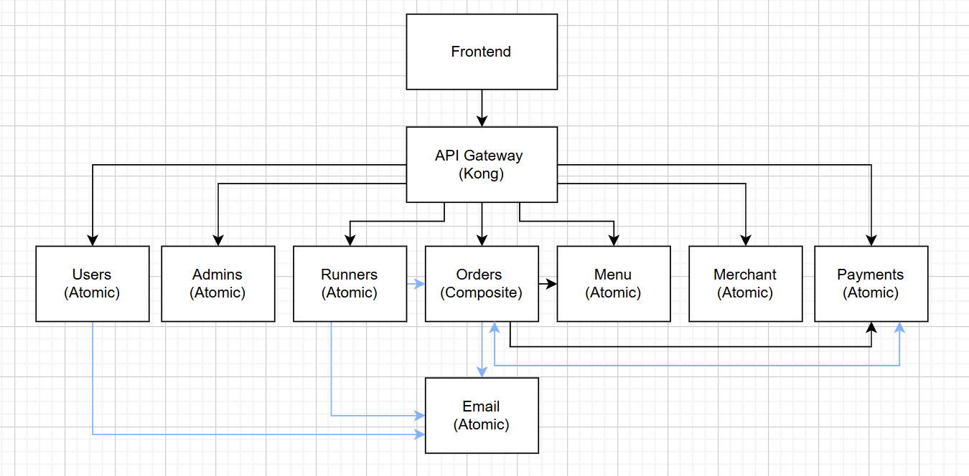
Our Microservices Architecture

Slide 6



How Campus Chow Works
Scenario 1
Scenario 2
Scenario 3
Customer orders from the app but forgot to make payment
Matching runners to orders
Merchant onboarding

Slide 7
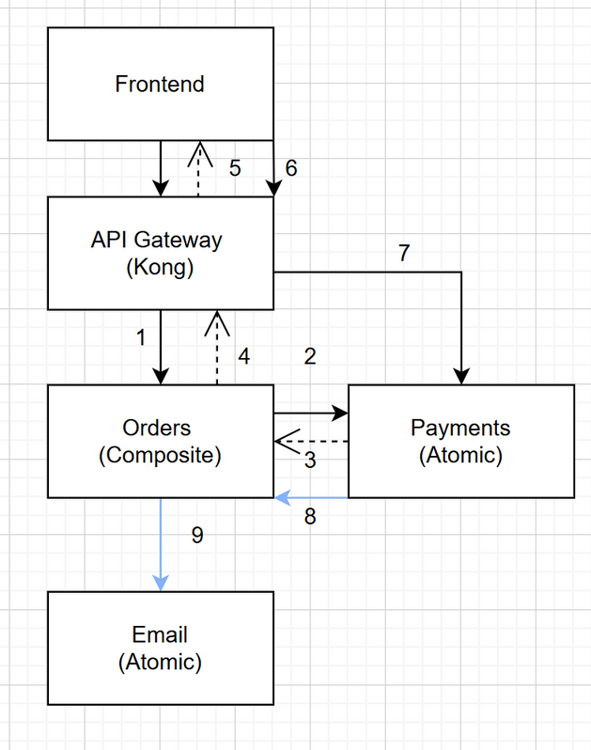
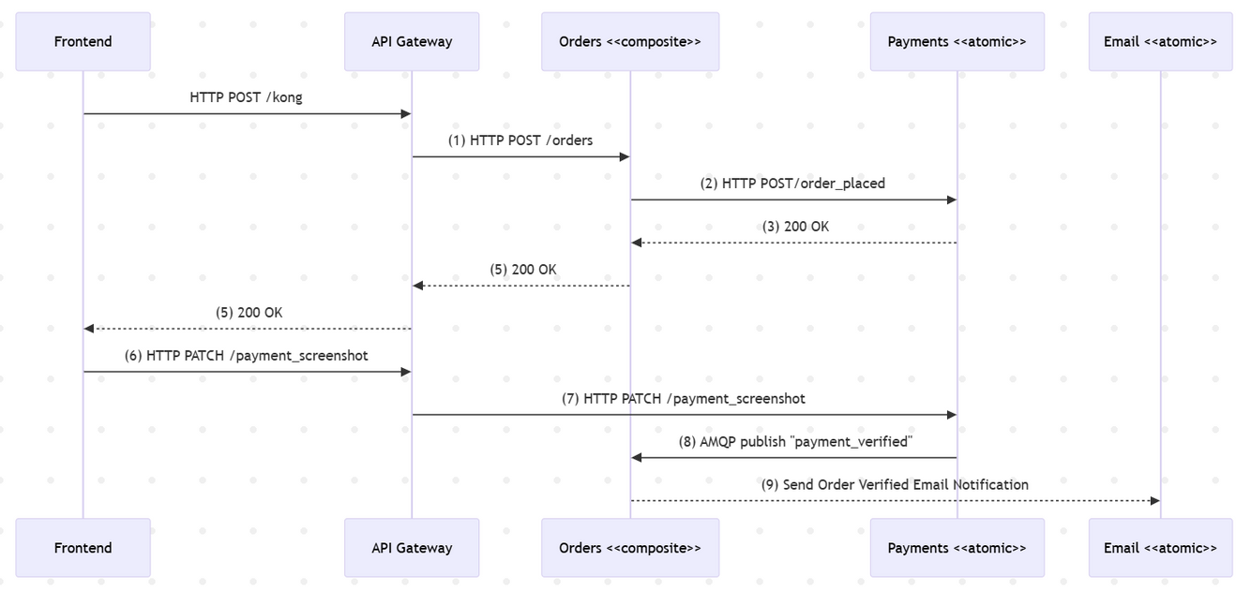
Scenario 1 : User successful order

Slide 8
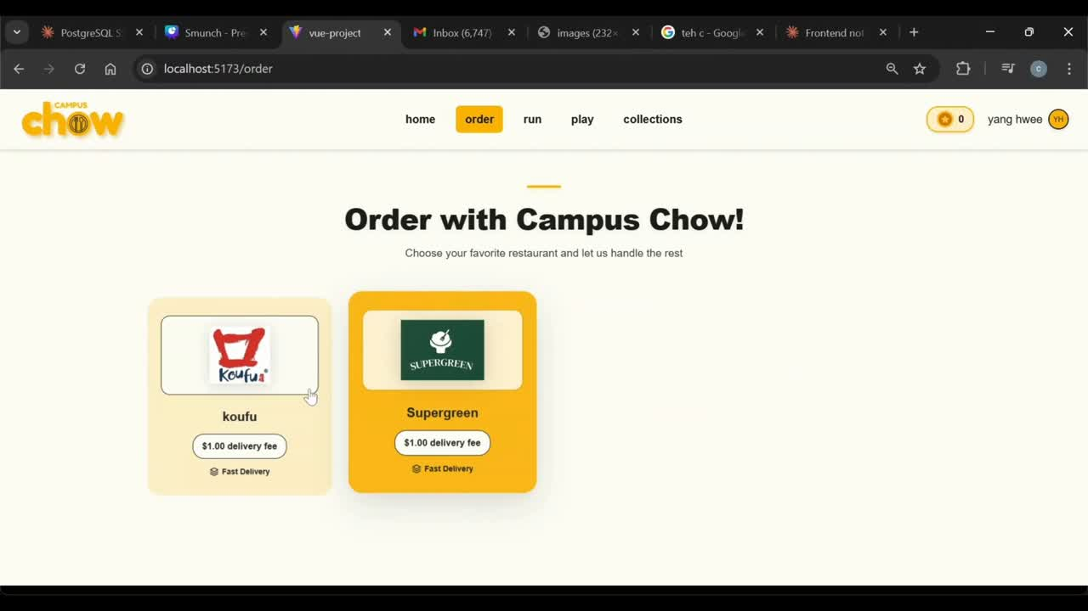
Scenario 1 : Demo

Slide 9
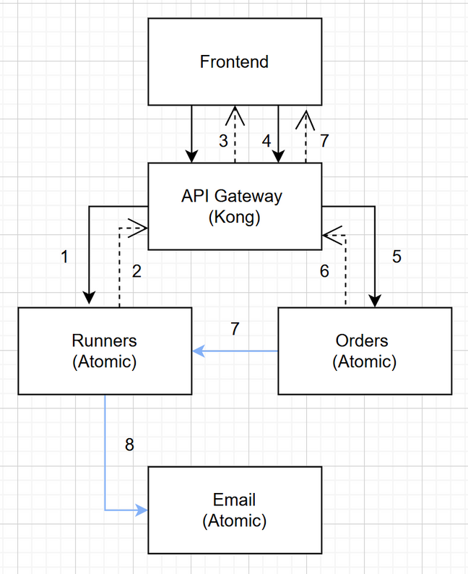
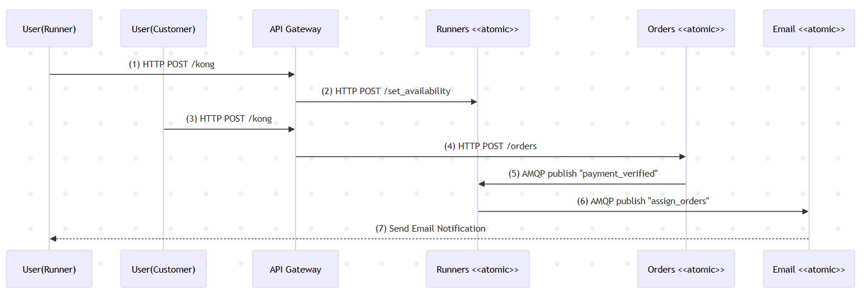
Scenario 2 : Assign orders to runners

Slide 10
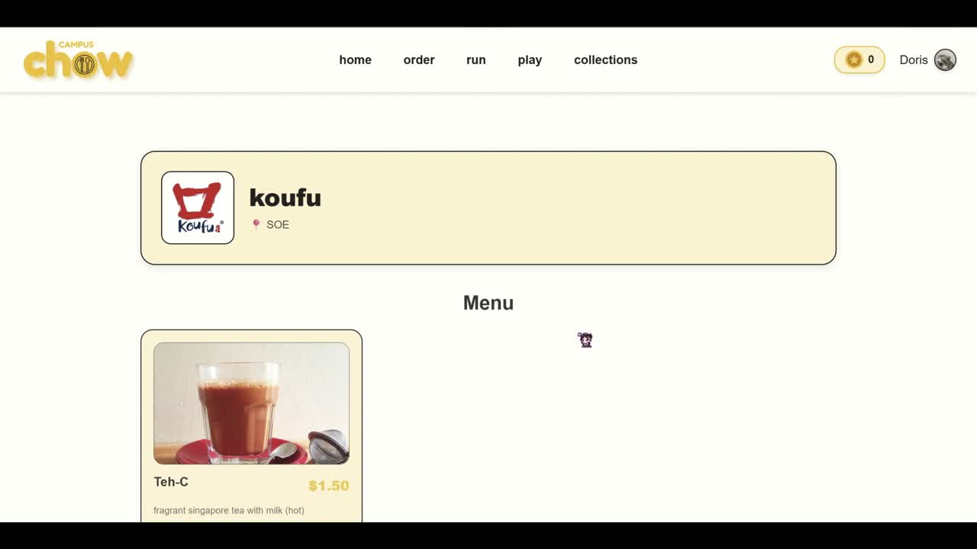
Scenario 1 : Demo

Slide 11
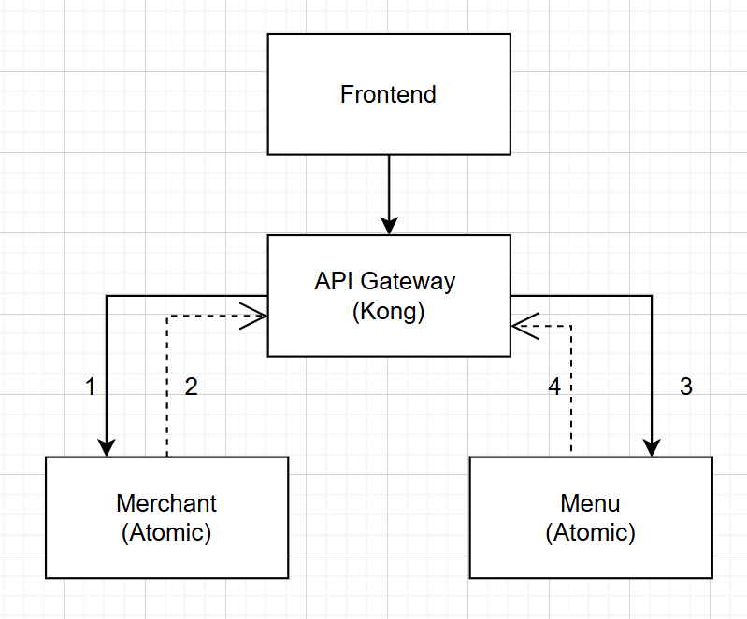
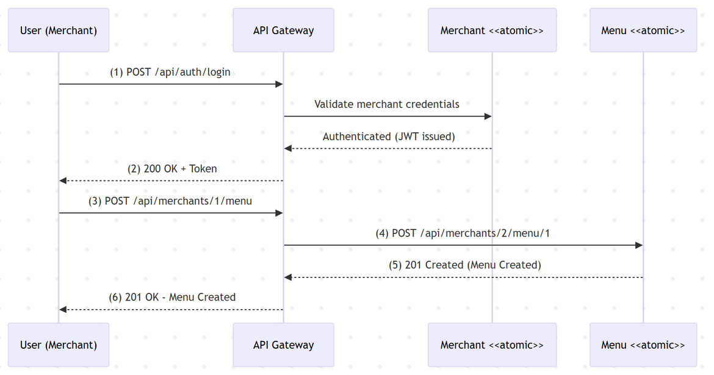
Scenario 3 : Merchant Onboarding

Slide 12

Demo

Slide 13
DevOps Practices
Version Control | GitLab | Manage code versions and enable collaboration
Containerization | Docker | Package microservices and databases
Orchestration | Docker Compose | To run the containers
Testing Automation | Unit + Integration Tests | Automated testing after pushing to GitLab

Slide 14

CI/CD Pipeline with GitLab
For our project, we implemented a fully automated CI/CD pipeline on GitLab.
pipeline automatically runs tests on every
commit / push
bugs caught early before reaching production
consistent build process using Docker
Separation of Concerns; frontend and backend
teams can iterate concurrently

Slide 15
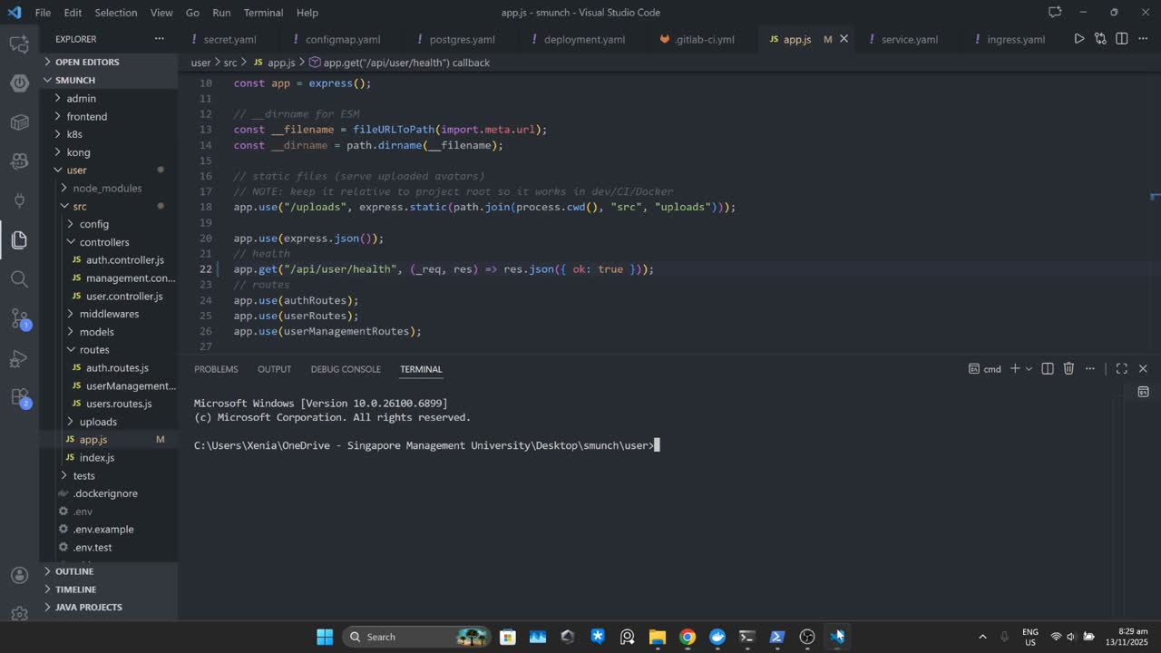
CI/CD Pipeline with GitLab

Slide 16
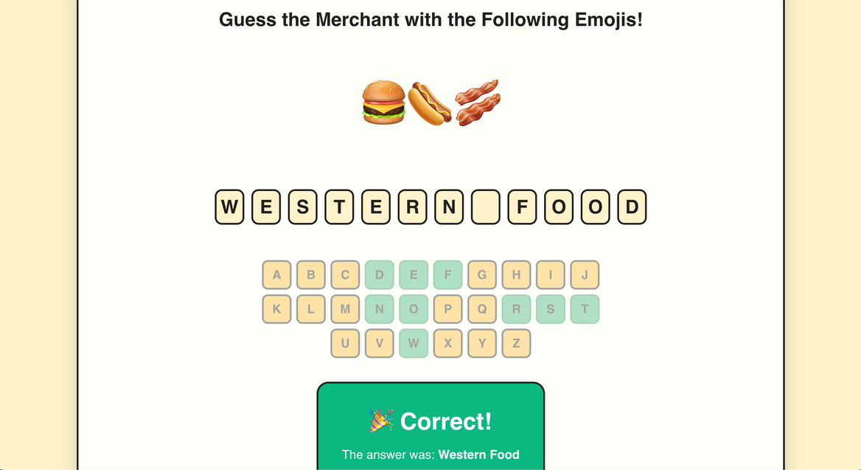
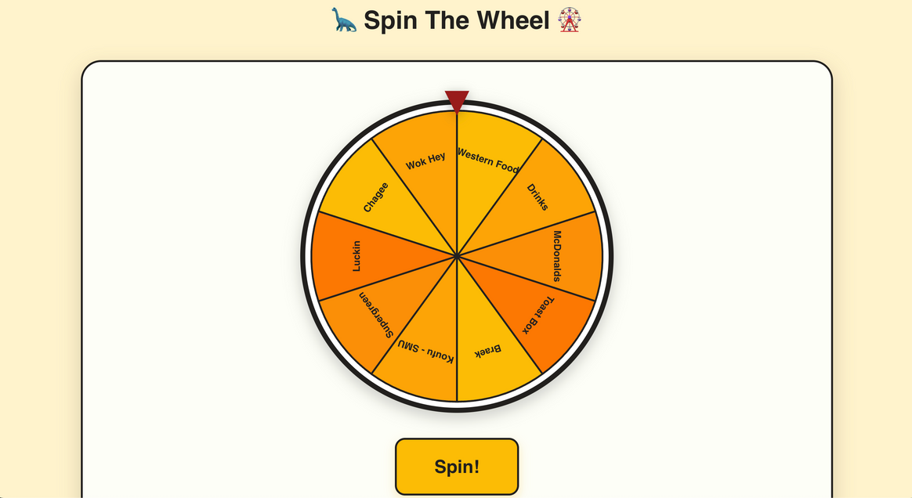
Bonus Website Features
Play Page

Slide 17

01
DevSecOps
Self-Directed Research
02
Kong API gateway
03
DevSecOps

Slide 18





DevSecOps
Automated security checks as part of tests
Spot errors early
Why not !
Notes:
OWASP Dependency-Check → Scans libraries for known vulnerabilities
SpotBugs + FindSecBugs → Finds security bugs in your code (SQL injection, XSS, etc.)
Secret Detection → Finds hardcoded passwords/API keys
Trivy Container Scan → Scans Docker images for vulnerabilities
Security Config Tests → Validates secure settings (passwords, ports, etc.)
JaCoCo Coverage → Ensures tests actually run
For example we can say that it caught on that we were hardcoded jwt tokens early on, which saved us time when it came to deployment

Slide 19

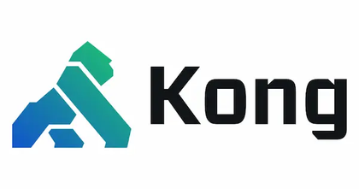
Kong API Gateway
API Rate Limiting
Prevents API abuse and DDoS attacks
Easy for frontend - all in one place
frontend
Notes:
OWASP Dependency-Check → Scans libraries for known vulnerabilities
SpotBugs + FindSecBugs → Finds security bugs in your code (SQL injection, XSS, etc.)
Secret Detection → Finds hardcoded passwords/API keys
Trivy Container Scan → Scans Docker images for vulnerabilities
Security Config Tests → Validates secure settings (passwords, ports, etc.)
JaCoCo Coverage → Ensures tests actually run
For example we can say that it caught on that we were hardcoded jwt tokens early on, which saved us time when it came to deployment

Slide 20

Thankyou

